Slide 1
VERTICAL GARDENING
By Capt. S.K.BHANDARI
& The ASFIC Team
09358525643

Slide 2
WHY VERTICAL GARDEN?
Build Your Own Vertical Garden. Living in a densely populated urban area, finding space to create a garden can be a bit of a challenge. But the solution to the problem was the in the utilization of vertical space.

Slide 3
VERTICAL GARDENING
Vertical gardening is an alternative gardening system that can replace the ordinary horizontal gardens. Vertical wall planters are used when there is not much space for gardening in an area, like on a porch, balcony or patio.

Slide 4
VERTICAL GARDENING
If you live in an urban area, you might not have much fertile soil to work with. Vertical wall planters are the best solution for this. Vertical wall planters can be used indoors and outdoors.

Slide 5
VERTICAL GARDENING
They also make watering plants easier. There are a variety of vertical wall planters you can choose from when building your living wall. Listed below are some examples.

Slide 6
VERTICAL GARDENING
Added Privacy:
Vertical planters can act as a privacy screen or a cover for a hole in the wall.

Slide 7
VERTICAL GARDENING
There is no limit to the design and style of vertical planters. Vertical planters add aesthetics to your home. They offer a lot more benefits including:

Slide 8
VERTICAL GARDENING
Vertical gardening systems allow you to grow flowers, herbs and vegetables. Lettuce is a common choice to plant in a vertical gardening system.

Slide 9
VERTICAL GARDENING
Imagine being able to harvest your own fruits and vegetables knowing that they are free from chemicals and commercial pesticides. Wouldn't that be a delight?

Slide 10
VERTICAL GARDENING

Slide 11
BUILD YOU OWN
What are you waiting for? Get started with a vertical gardening system today and enjoy the benefits many other vertical garden growers are experiencing!

Slide 12
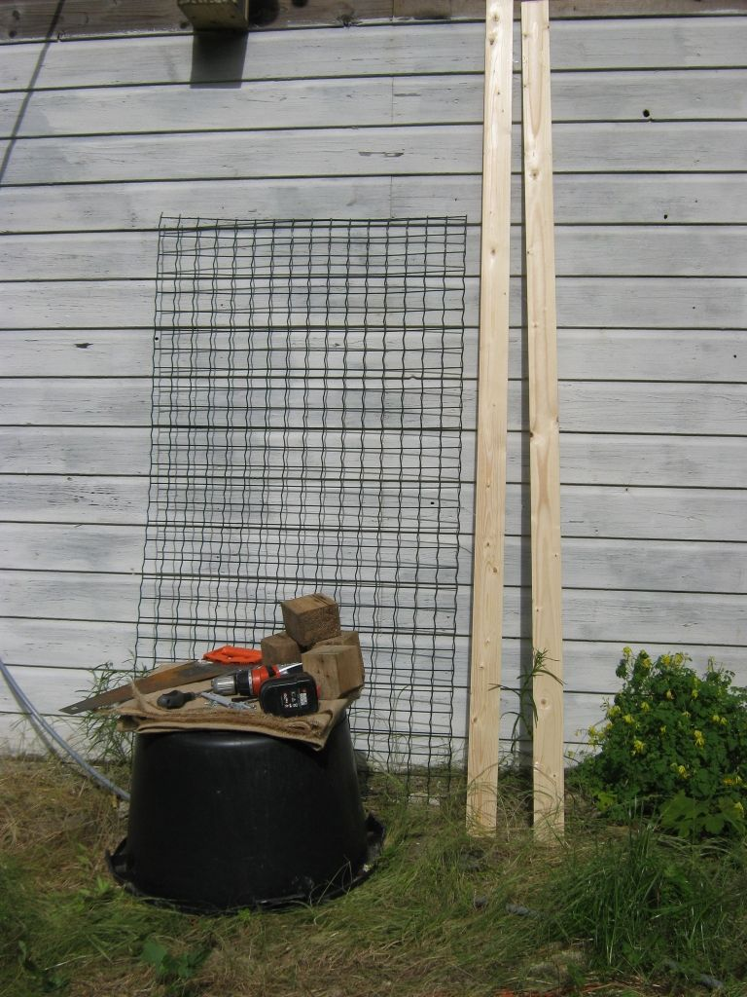
THINGS YOU NEED

Slide 13
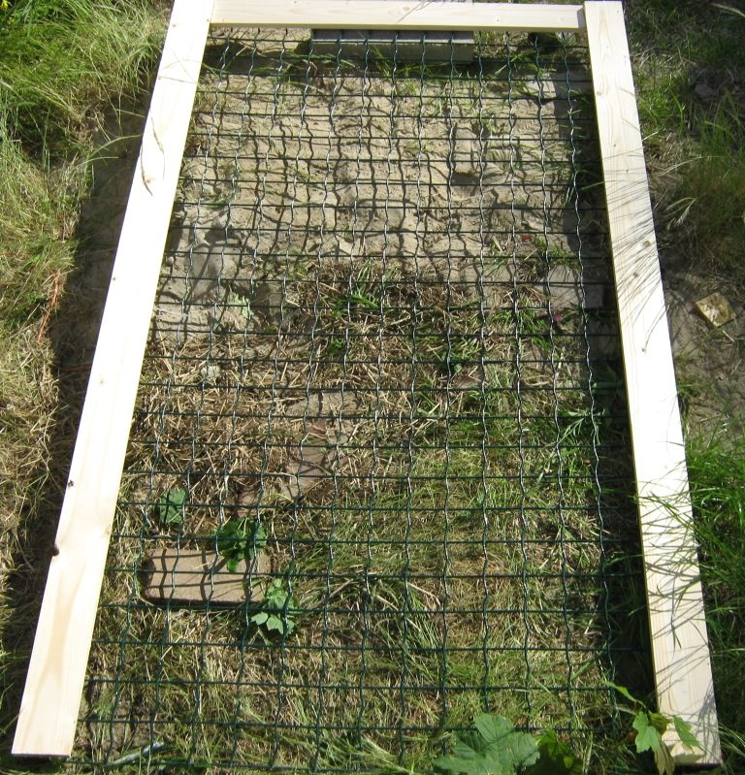
MAKING THE FRAME

Slide 14
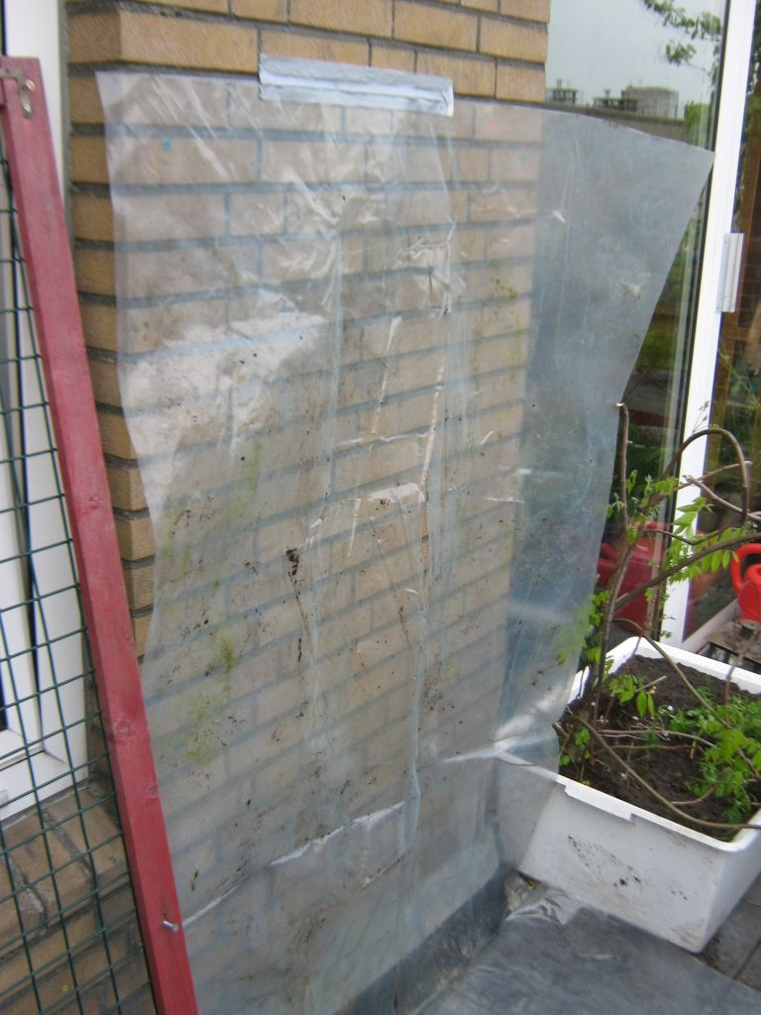
FIXING PVC SHEET TO THE WALL

Slide 15
VERTICAL GARDENING

Slide 16
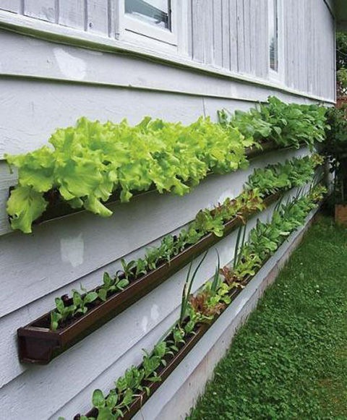
VERTICAL GARDENING

Slide 17
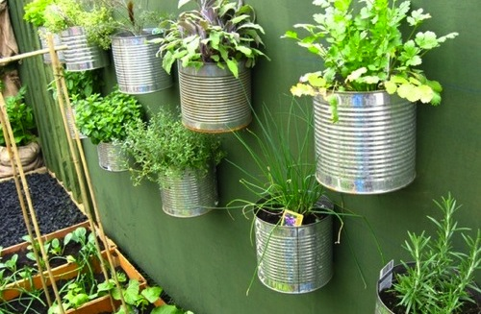
VERTICAL GARDENING

Slide 18
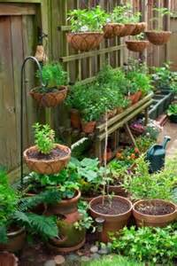

Slide 19
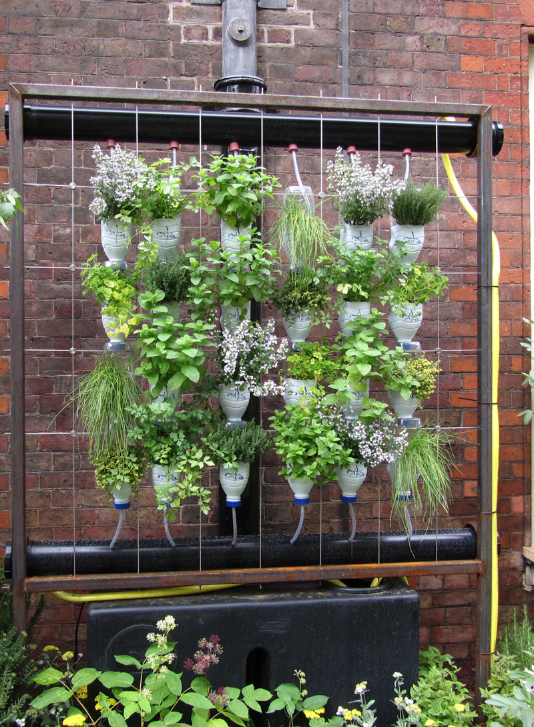
VERTICAL GARDENING

Slide 20
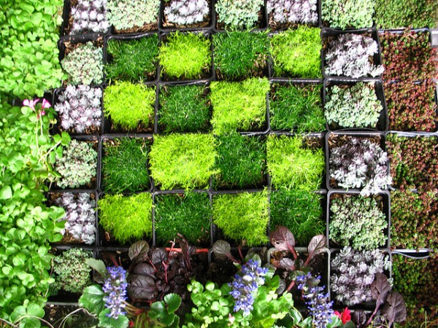
VERTICAL GARDENING

Slide 21
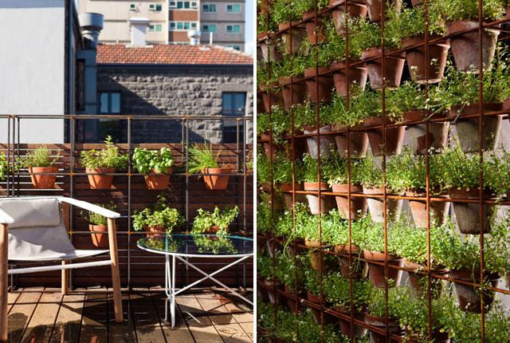
VERTICAL GARDENING

Slide 22
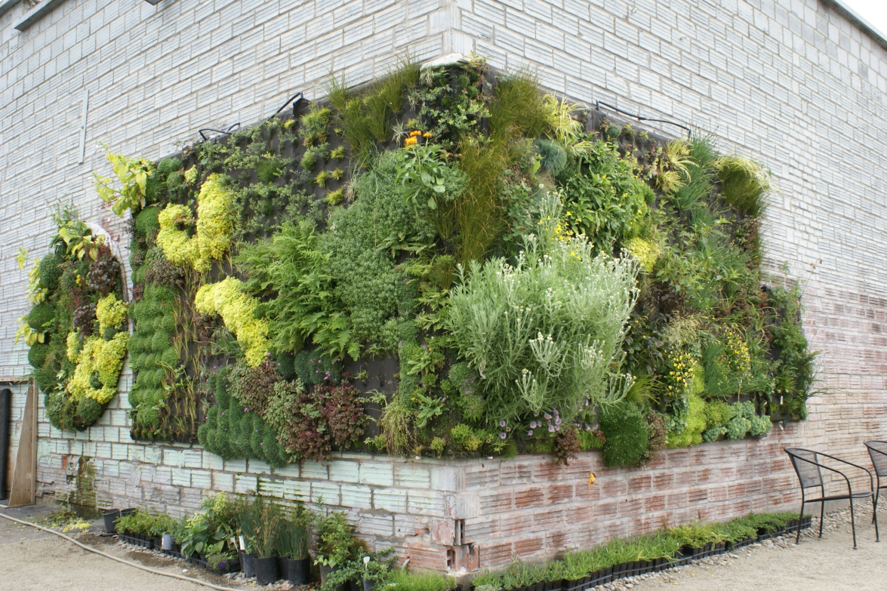
VERTICAL GARDENING

Slide 23
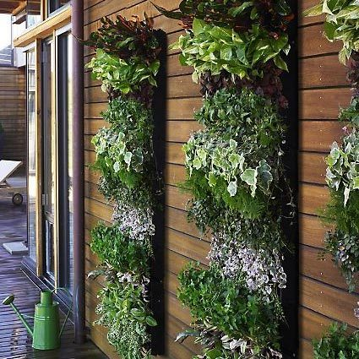
VERTICAL GARDENING

Slide 24
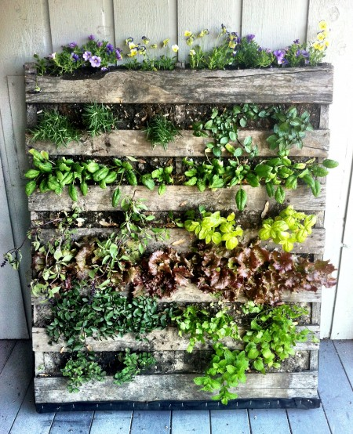
VERTICAL GARDENING

Slide 25
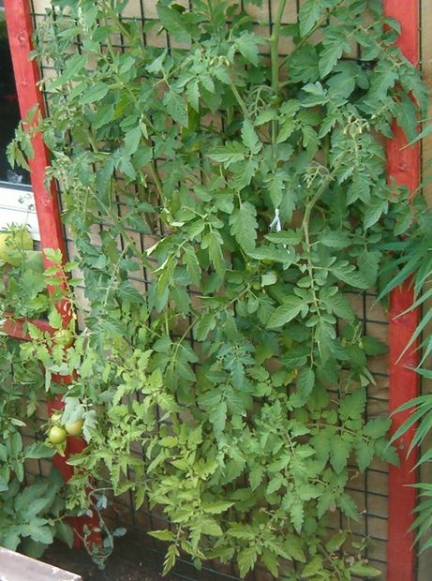
VERTICAL GARDENING

Slide 26
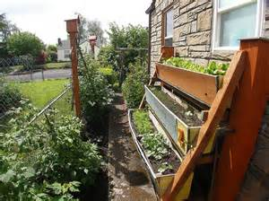
VERTICAL GARDENING

Slide 27
VERTICAL GARDEN

Slide 28
PLANNING
The first step in planning your vertical gardening system is to determine the site or wall for your plants. Make sure the site on your vertical garden plans gets very good sun exposure.

Slide 29
PLANNING CONTD.
Determine the area coverage for your vertical garden. Indicate this in your vertical garden plans. If you are building a tower planter, then determine and indicate the height and/or diameter in your vertical garden plans.

Slide 30
VERTICAL GARDEN

Slide 31
VERTICAL GARDENING PLANS
Vertical garden plans are best for covering ugly walls, making privacy dividers, or covering exterior walls. If you have a small growing space, you should consider vertical garden plans to maximize the space.

Slide 32
VERTICAL GARDENING
If you need more tips on how to make vertical garden plans, feel free to consult other sources online or talk to your local gardening center specialist. Vertical gardens are easy to maintain and would make a great addition to any home or office.

Slide 33
VERTICAL GARDEN

Slide 34
Plant Pockets
Plant pockets are vertical wall planters that have a design that allows your plants to be portable, so you can safely transfer your plants anywhere you like without the hassle of re-potting..

Slide 35
Plant Pockets
Plant pockets look great on any wall, indoors and outdoors. They are very stylish and would look good even in urban home designs.

Slide 37
LIVING WALLS
Living walls are a unique addition to your home or workplace. Imagine living walls in your living room or in a conference room, it can be very refreshing and relaxing to the eyes!

Slide 38
LIVING WALLS
As the name implies, these living walls bring life to any indoor or outdoor setting while providing many benefits like filtering the surrounding air

Slide 39
LIVING WALLS
Giving a classy look to your walls and having your own growing garden even if you live in a tiny urban space. You can enjoy more benefits if you build your living walls. When building living walls, you have to keep in mind the following:

Slide 40
LIVING WALLS
Locate your living walls where it will receive enough sunlight. If you are building indoor living walls, be sure to place it near a window or have the right grow lights installed for them. Natural or artificial light are essential for plants to continue to grow and not wither quickly.

Slide 41
LIVING WALLS

Slide 42
LIVING WALLS

Slide 43
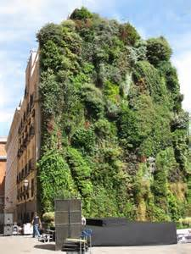
LIVING WALLS

Slide 44
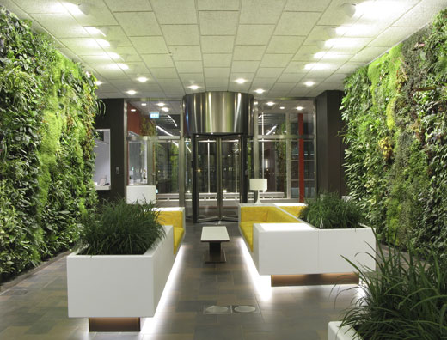

Slide 45
ANY QUESTIONS

Slide 46
THANK YOU

